Slide 1
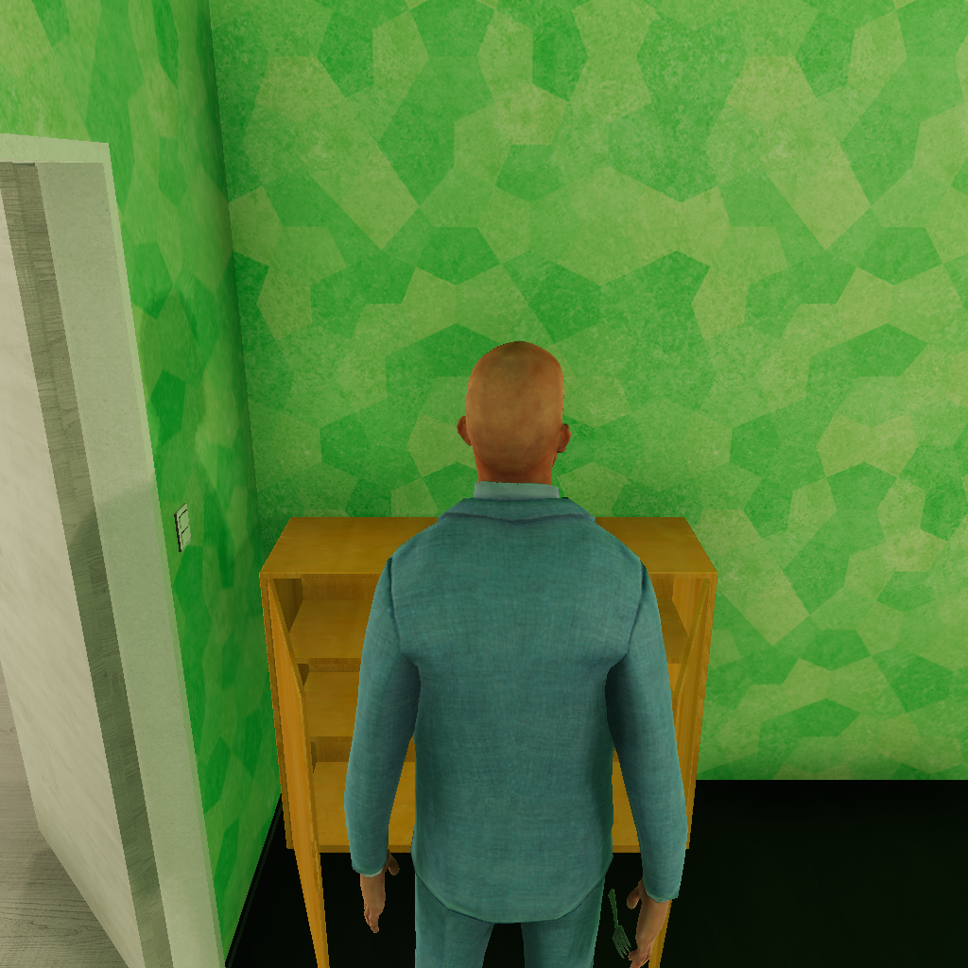
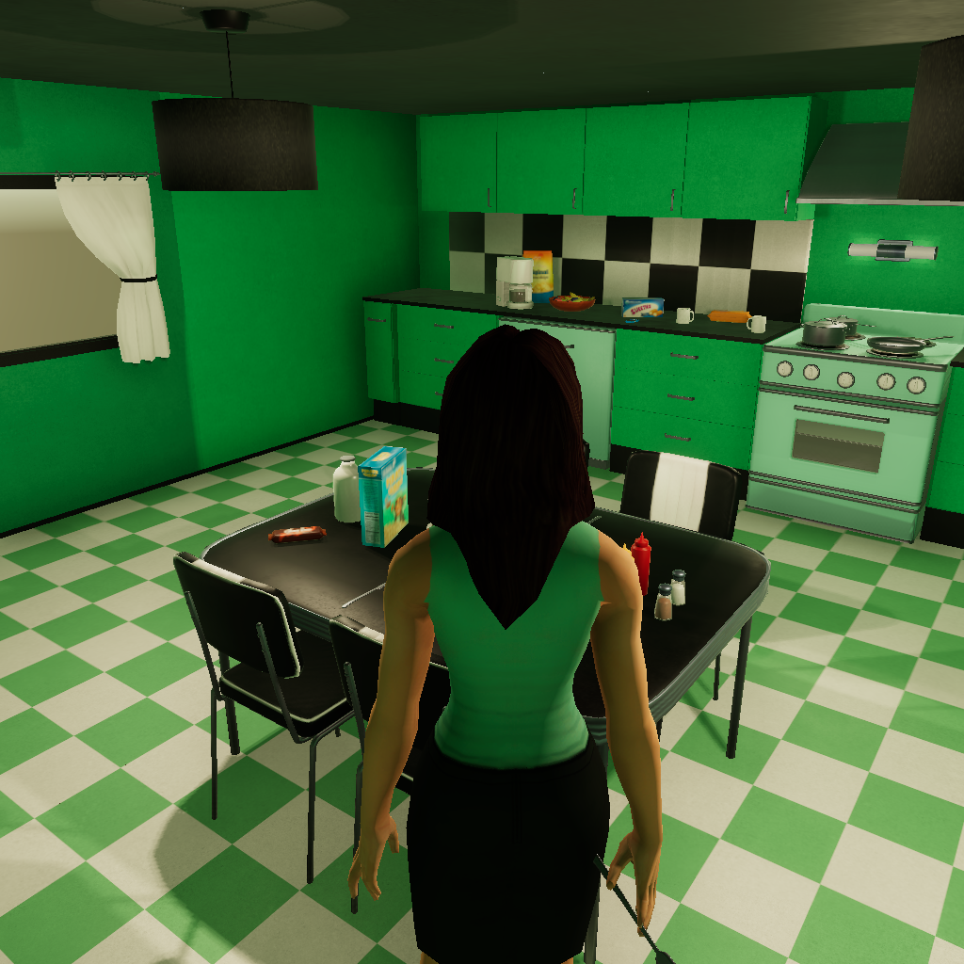
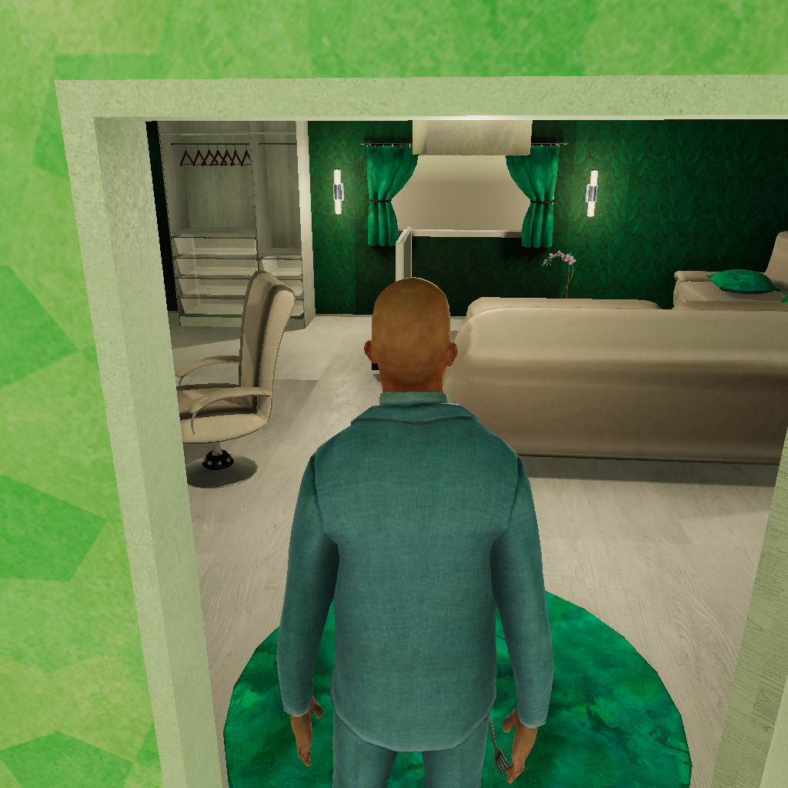
Bob: “Hey Alice, I found a <cutleryfork> (374) in the <bedroom>. I‘m heading to the kitchen to explore. Please check the living room or bathroom for more <cutleryforks>. Let's regroup at the <dishwasher> (104) when we find all three!”
Bob shares his progress and suggests a labor division.
Alice suggests another plan since she's already in the kitchen.
Bob agrees with Alice and adjusts his plan to cooperate with Alice.
Alice: “Hi Bob, I found a <cutleryfork> (373) and the <dishwasher> (104) in the <kitchen>.
Please check the living room for more cutleryforks while I explore the remaining kitchen cabinets.
Let's meet at the dishwasher when we have all three forks!”

Slide 2
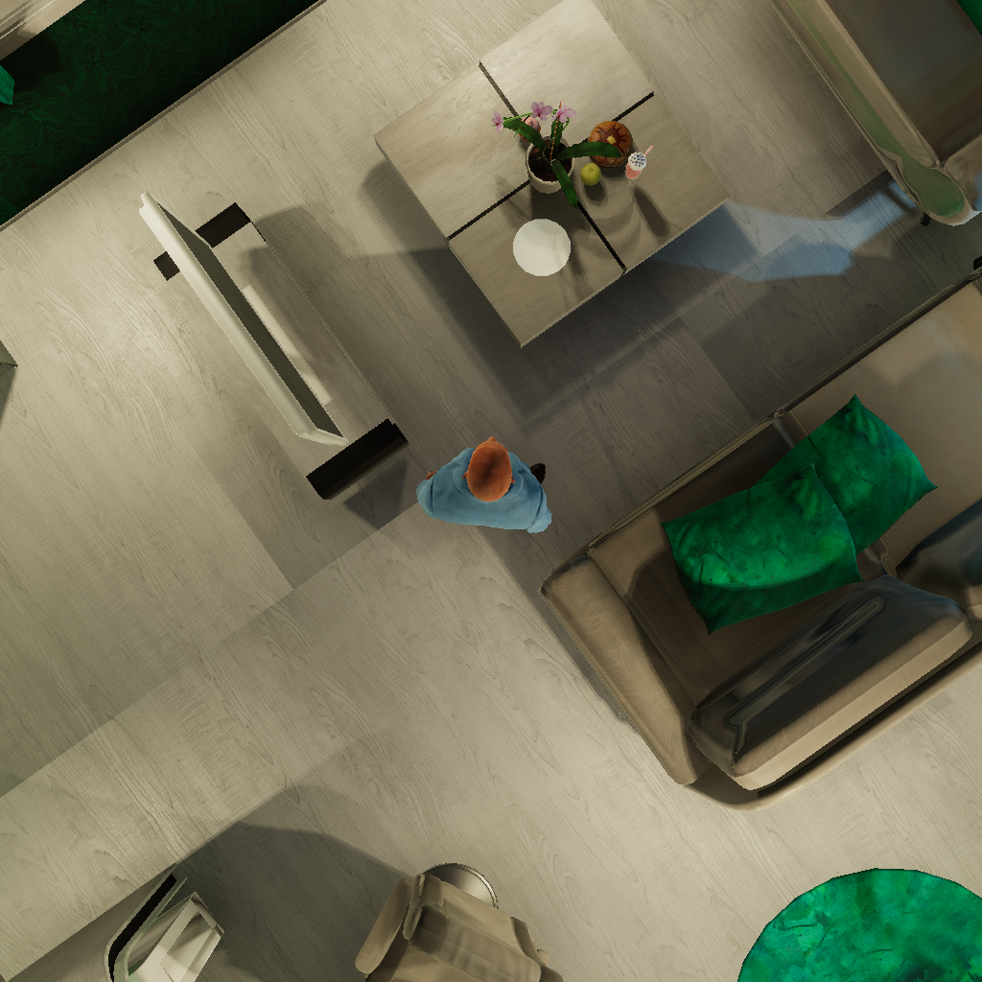
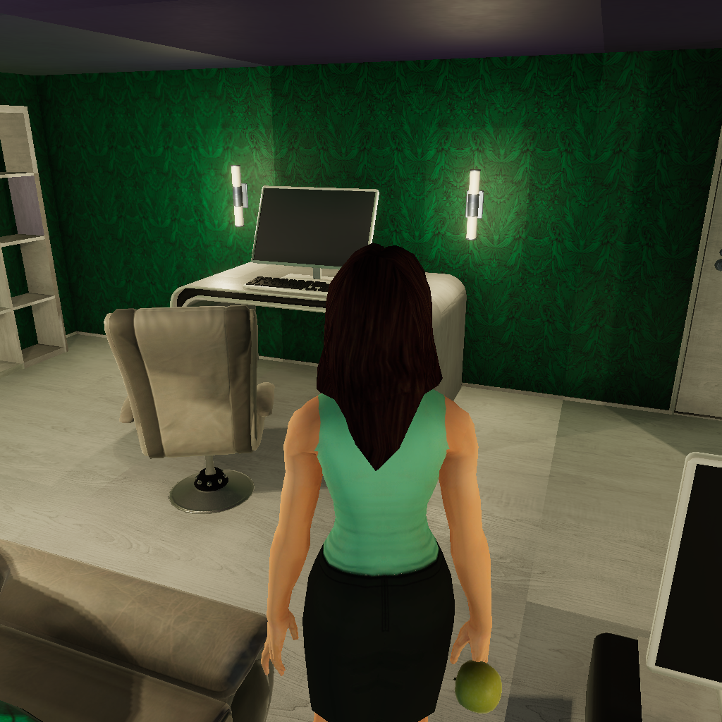
Bob: “Hey Alice, I've got a <cupcake> (375) and found an <apple> (377) in the <livingroom>.
Let's explore the kitchen, bathroom, and bedroom for the other items.
Can you grab the <apple> (377)? Let me know your location too.”
Bob requests help from Alice to grab an apple in the livingroom.
Alice helps and responses.
Alice: “Hey Bob, I've grabbed the <apple> (377) and put the <poundcake> (372) in the <fridge> (103). I'm in the <livingroom> now. Please put the <cupcake> (375) in the <fridge> (103) and check the <cabinet> (216) in the bedroom. I'll explore the bathroom and kitchen cabinets for the remaining items.”

Slide 3
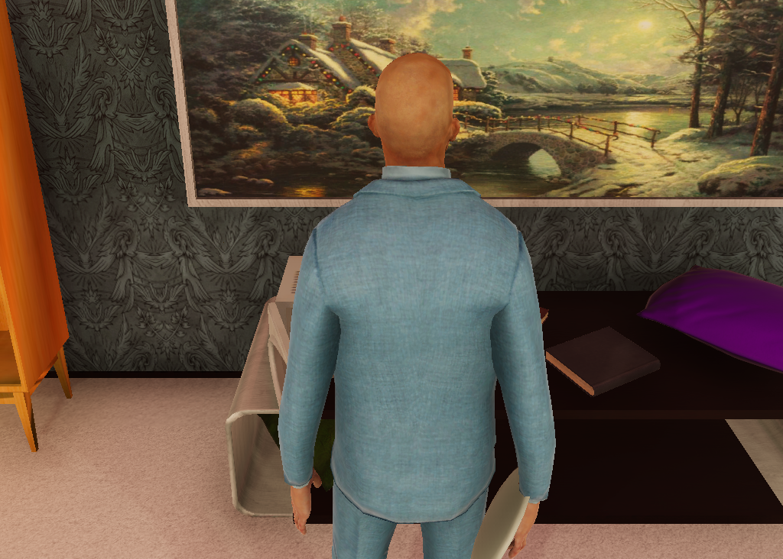
Alice: “Let's update each other with any findings.”
Bob finds a plate and chooses to directly put it on the table instead of sharing this with Alice first for higher efficiency

Slide 4
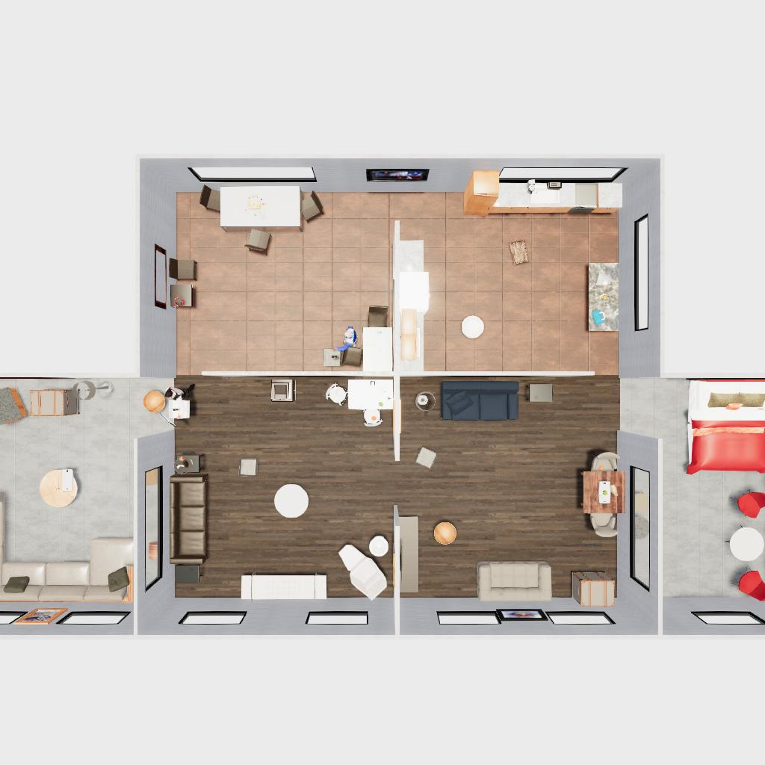
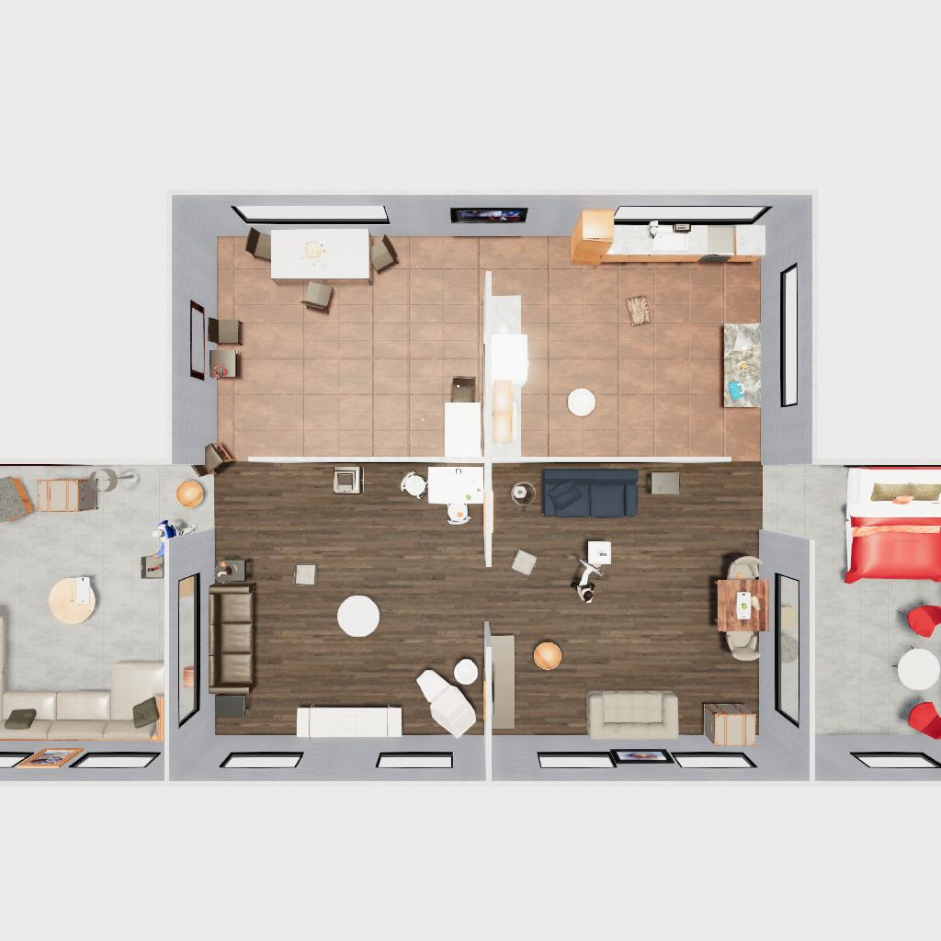
Bob: “Alice, I'm in the <Livingroom> (4000) with a full container <plastic_basket> (7406). Please pick up a container from <Office> (2000) or <Livingroom> (3000), collect the <iphone> (8911) in <Livingroom> (1000).”
Bob requests Alice to grab a new target.
Alice goes there and grabs it.
Bob: “Alice, I'm in the <Livingroom> (4000) with a full container <plastic_basket> (7406). Please pick up a container from <Office> (2000) or <Livingroom> (3000), collect the <iphone> (8911) in <Livingroom> (1000).”
Bob requests Alice to grab a new target.
Alice goes there and grabs it.
Alice thinks: First, you should go to the <Livingroom> (1000) where the target object <iphone> (8911) is located. So, choose action go to <Livingroom> (1000).

Slide 5
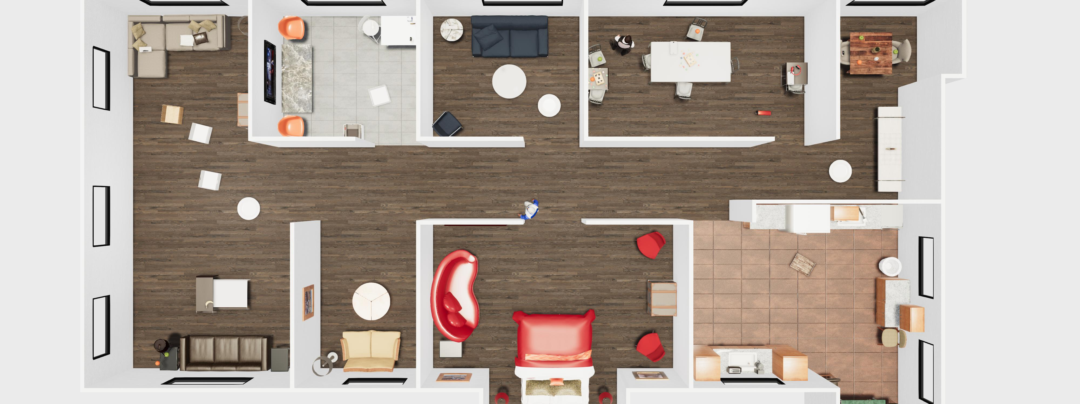

e.
Alice: “Bob, I‘ve found the bed in the Bedroom (8000) and fully explored it. I suggest you gather the purse in the Office (4000) and containers from the Livingroom (2000) or Office (1000). ”
Alice shares information with Bob, and Bob receives and responds with his plan.
Bob: “Alice, I'm in the Livingroom (3000) with an iphone (6929) and found a lighter (5166) and another iphone (1852) here. I'll head to Livingroom (2000) for containers and then Office (4000) for the purse. ”

Slide 6
a. adapt plans
b. respond to requests
Bob: “Hey Alice, I've got a <cupcake> (375) and found an <apple> (377) in the <livingroom>. Let's explore the kitchen, bathroom, and bedroom for the other items. Can you grab the <apple> (377)? Let me know your location too.”
Bob: “Hey Alice, I found a <cutleryfork> (374) in the <bedroom>. I‘m heading to the kitchen to explore. Please check the living room or bathroom for more <cutleryforks>. Let's regroup at the <dishwasher> (104) when we find all three!”
Bob shares his progress and suggests a labor division.
Alice suggests another plan since she's already in the kitchen.
Bob agrees with Alice and adjusts his plan to cooperate with Alice.
Bob requests help from Alice to grab an apple in the livingroom.
Alice helps and responses.
Alice: “Hey Bob, I've grabbed the <apple> (377) and put the <poundcake> (372) in the <fridge> (103). I'm in the <livingroom> now. Please put the <cupcake> (375) in the <fridge> (103) and check the <cabinet> (216) in the bedroom.”
Alice: “Hi Bob, I found a <cutleryfork> (373) and the <dishwasher> (104) in the <kitchen>.
Please check the living room for more cutleryforks while I explore the remaining kitchen cabinets.
Let's meet at the dishwasher when we have all three forks!”
c. not to communication
d. know when to request
e. share information
Alice: “Let's update each other with any findings.”
Bob: “Alice, I'm in the <Livingroom> (4000) with a full container <plastic_basket> (7406). Please pick up a container from <Office> (2000) or <Livingroom> (3000), collect the <iphone> (8911) in <Livingroom> (1000).”
Alice: “Bob, I‘ve found the bed in the Bedroom (8000) and fully explored it. I suggest you gather the purse in the Office (4000) and containers from the Livingroom (2000) or Office (1000). ”
Bob requests Alice to grab a new target.
Alice goes there and grabs it.
Bob requests Alice to grab a new target.
Alice goes there and grabs it.
Alice goes there and grabs it.
Bob finds a plate and chooses to directly put it on the table instead of sharing this with Alice first for higher efficiency
Alice shares information with Bob, and Bob receives and responds with his plan.
Alice thinks: First, you should go to the <Livingroom> (1000) where the target object <iphone> (8911) is located. So, choose action go to <Livingroom> (1000).
Bob: “Alice, I'm in the Livingroom (3000) with an iphone (6929) and found a lighter (5166) and another iphone (1852) here. I'll head to Livingroom (2000) for containers and then Office (4000) for the purse. ”

